Slide 1

FERRARI BATTERY LIFE PREDICTION

Slide 2
The client “Ferrari” would like to predict the life of battery installed in the hybrid car so that it can send message to the customers beforehand to avoid critical hours support and eventually can enhance customers’ satisfaction and brand valuation. Hybrid cars are type of cars that run in battery and fuel. The client would like to know how they can leverage all the data that are stored in the advanced sensors embedded in the car to predict accurately the remaining life of the battery.
Problem Definition :

Slide 3
Assessing the problem:
Complication:
Client does not know how the data stored in the advanced sensors can be analysed to predict the battery life and inform the customer before ending up in a critical situation.
Current Situation:
The customers are not prompted (or) informed about the status or heath of the battery.
Desired State:
The battery life has to be predicted using the data obtained by the advanced embedded sensors in the hybrid car and the customer has to be prompted about accurate remaining battery life before he/she ends up in a critical situation.
Key Question:
How can the embedded sensors data be analysed?
How will the customer be informed?

Slide 4
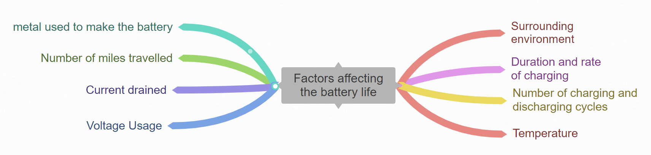
Factors affecting the battery life:

Slide 5
Analysing the data obtained from the sensors:
Voltage usage and current drained | The voltage usage and current drained can be obtained using an appropriate algorithm on the data obtained from the embedded sensors.
Number of charge and discharge cycles | The cycles can be obtained once the voltage and current are determined. The cycle differs from one type to another type of battery.
Temperature | The values of temperature can be obtained from the temperature sensor embedded.
Miles travelled | Similar to the temperature, number of miles can be obtained from the sensors embedded.

Slide 6
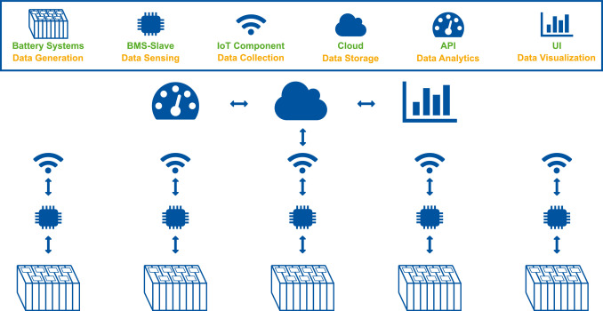

Slide 7
THANK YOU

